Slide 1
CSE 1205
Electrical Engineering & Circuit Analysis
Md. Tanzid Mia
Lecturer
Department of CSE
Northern University Bangladesh.
Initial: MTM
Contact: tanzid.eee.nub@gmail.com

Slide 2
CSE 1205: Electrical Engineering & Circuit Analysis Credit Hours: 3.00
Course Content: Fundamental electric concepts and measuring units, current and voltage, Resistance and power. Laws of electrical circuit, source conversions. Method of Network analysis, Basic passive Elements; Fundamental of Alternating current, Average power and power factor, instantaneous and r.m.s current, voltage and power for various combination of R, L and C circuits. Phasor representation of sinusoidal quantities, frequency response of the basic element, Resonance, Single and polyphase A.C. circuit analysis.
Book References:
Introductory Circuit Analysis: Robert L. Boylested
A Textbook of Electrical Technology: B.L Theraja
Alternating Current Circuits: George F. Corcoran
Fundamentals of Electric Circuits by Charles K. Alexander and Matthew N.O. Sadiku

Slide 3
Fundamental Electrical Concepts & Measuring Units

Slide 4
Charge: Charge is an electrical property of the atomic particles of which matter consists, measured in coulombs (C).
The following points should be noted about electric charge:
The coulomb is a large unit for charges.
According to experimental observations, the only charges that occur in nature are integral multiples of the electronic charge.
The law of conservation of charge states that charge can neither be created nor destroyed, only transferred. Thus the algebraic sum of the electric charges in a system does not change.

Slide 5
The convention is current flows opposite to electron. This convention was introduced by American scientist Benjamin Franklin (1706–1790).

Slide 6
Voltage: The electric potential between one place and another. How much the electricity wants to move from one point to another. Voltage is a kind of force for electrons. Measured in volts.
Current: How many positive or negative charges are moving per second through a conductor. Measured in amperes.
Resistance: Resistance is a measure of the opposition to current flow in an electrical circuit. Resistance is measured in ohms

Slide 7
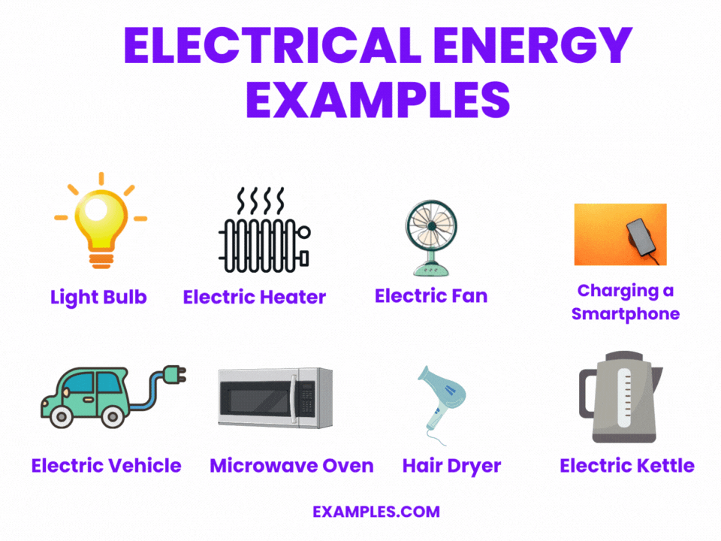
Energy: Electrical Energy is the ability of an electrical circuit to produce work by creating an action. This action can take many forms, such as thermal, electromagnetic, mechanical, electrical, etc. Electrical energy can be both created from batteries, generators, dynamos, and photovoltaics, etc. or stored for future use using fuel cells, batteries, capacitors or magnetic fields, etc. Thus electrical energy can be either created or stored.
Power: Electrical Power can be defined as the rate at which work is performed in expending energy.

Slide 8
Laws of Electrical Circuit

Slide 9
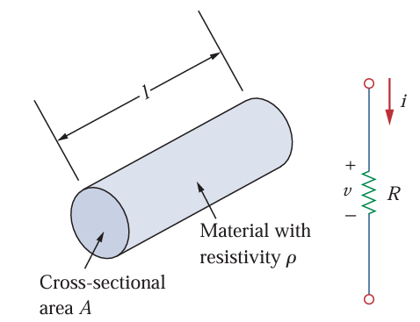

Resistance of Conducting Material: Materials in general have a characteristic behavior of resisting the flow of electric charge. This physical property, or ability to resist current, is known as resistance and is represented by the symbol R. The resistance of any material with a uniform cross-sectional area A depends on A and its length l.
where is ρ known as the resistivity of the material in ohm-meters. Good conductors, such as copper and aluminum, have low resistivities, while insulators, such as mica and paper, have high resistivities.

Slide 10
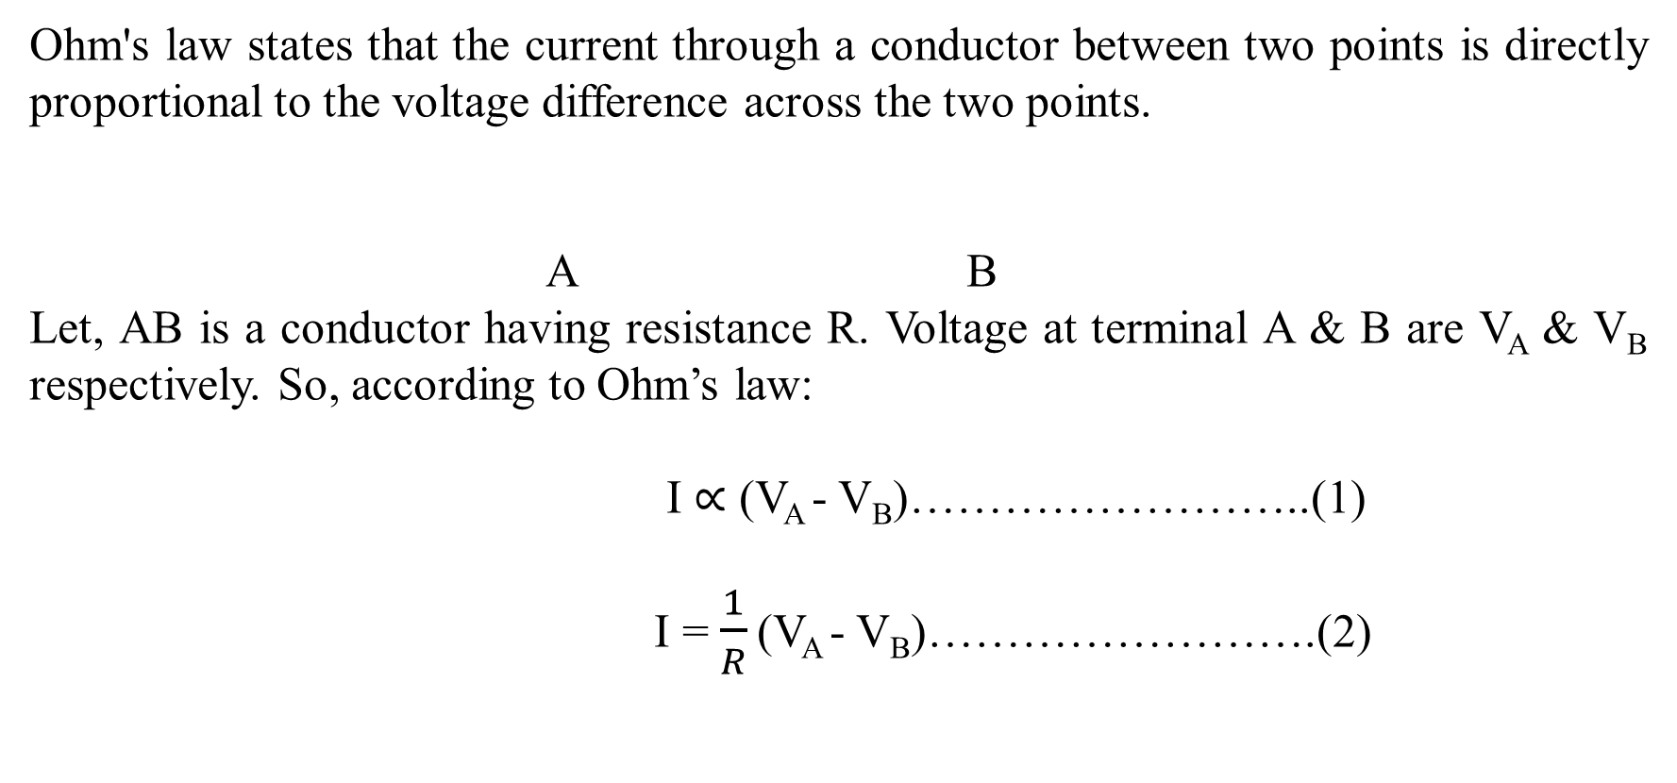

Ohm’s Law

Slide 11
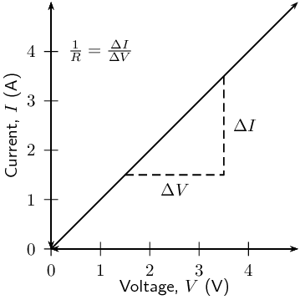
Ohm’s Law

Slide 12
Basic Definitions
Linear Network: A Linear circuit is one whose parameters (R, L & C) are constant with time and they do not change with voltage or current and circuit obeys Ohm's Law.
Non-Linear Network: A Non Linear circuit is that circuit whose parameters change with voltage or current and circuit does not obey Ohm's Law.
Unilateral Network: A network whose response changes with interchanging of load and source.
Bilateral Network: A network where the response doesn’t change with interchanging of load and source.

Slide 13
Basic Definitions
Circuit: The electrical circuit is a path through which the current flows due to the difference in the potential. In an electrical circuit, all connections should be closed.
Network: Electric Network is a network or connection of a number of electrical elements that are connected in any manner, either open or closed.
Node: A point at which two or more elements are joints together is called node.
Junction: A point where three or more branches meet together is called a junction.

Slide 14
Mesh: A mesh is a closed path in a circuit with no other paths inside it.
Loop: Any closed path in the circuit.

Slide 15
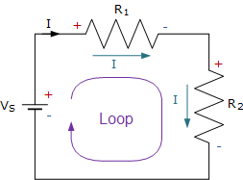
Kirchhoff’s Voltage Law
Kirchhoff's Voltage Law (KVL) states that for any closed loop in a circuit, the sum of the potential differences across all components is zero.
-V_{s}+ IR₁ + IR₂ = 0

Slide 16
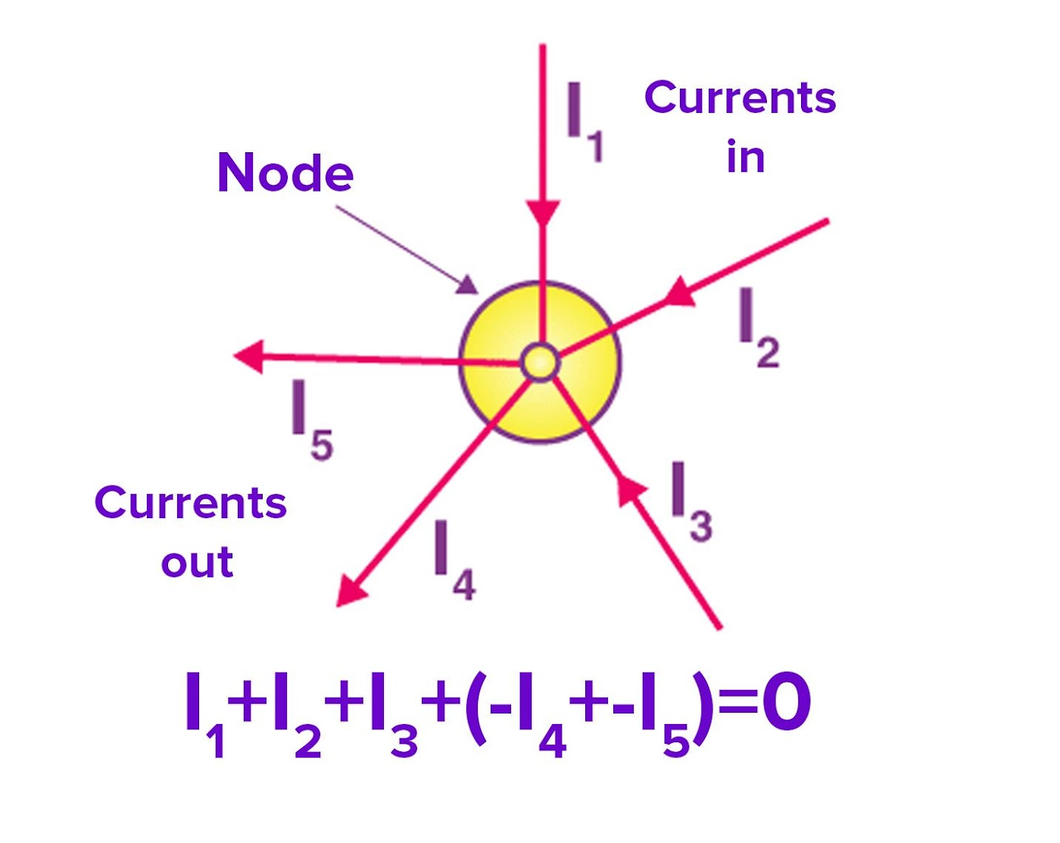
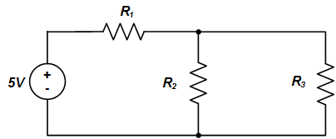
Kirchhoff’s Current Law
The algebraic sum of all currents entering and exiting a node must equal zero.
I₁
I₂
I₃
I₁ = I₂ + I₃

Slide 17
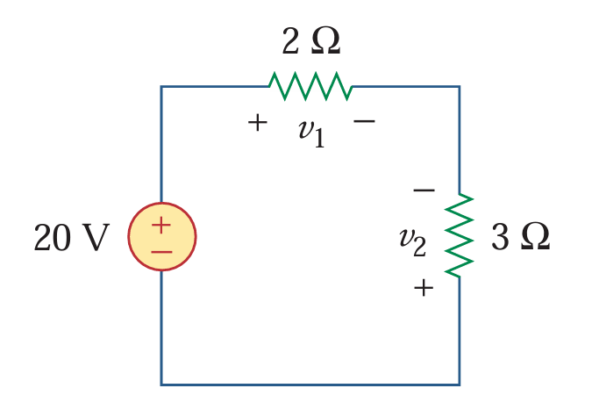
Problem-1

Slide 18
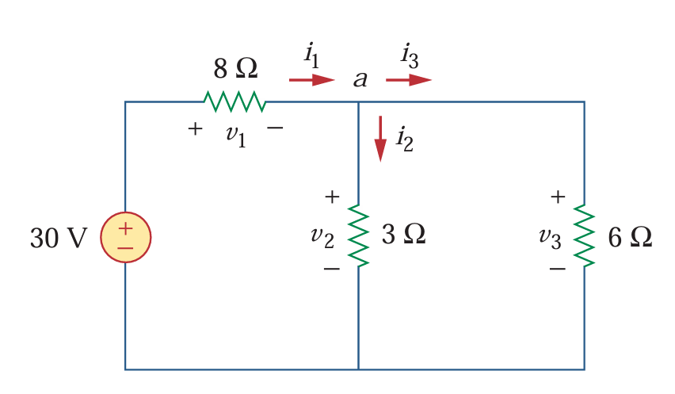
Problem-2

Slide 19
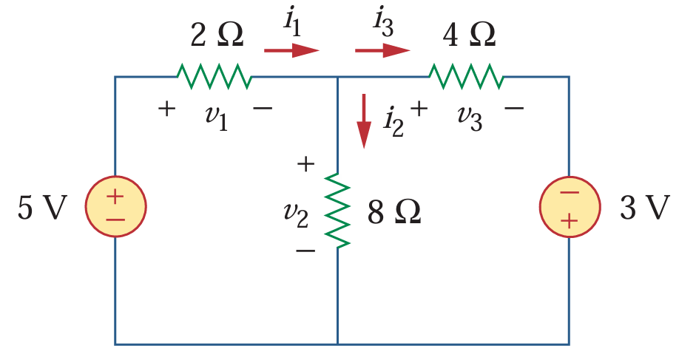
Problem-3

Slide 20
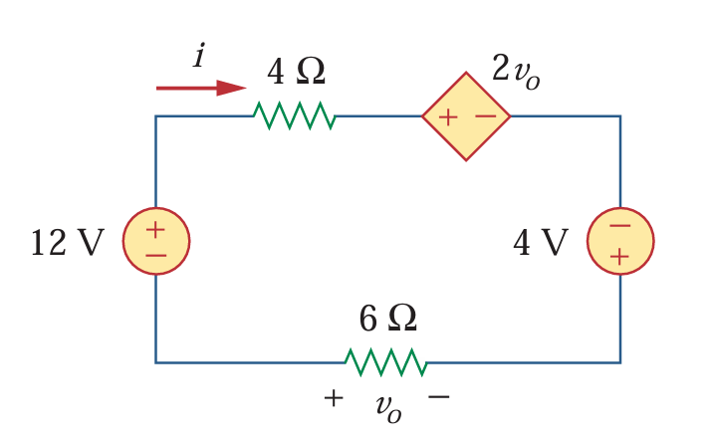
Problem-4

Slide 21
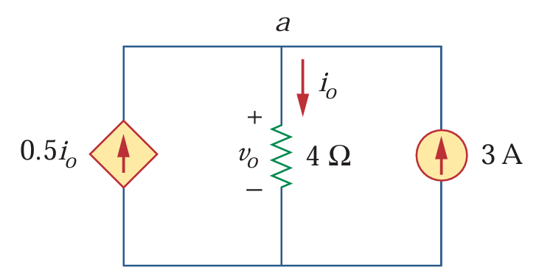
Problem-5

Slide 22
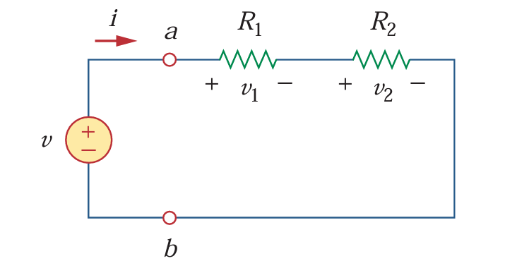
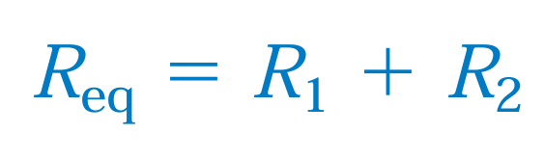
Equivalent Resistance:

Slide 23
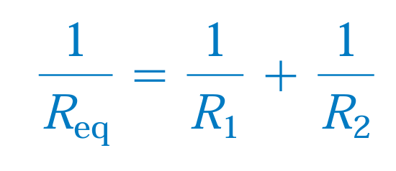
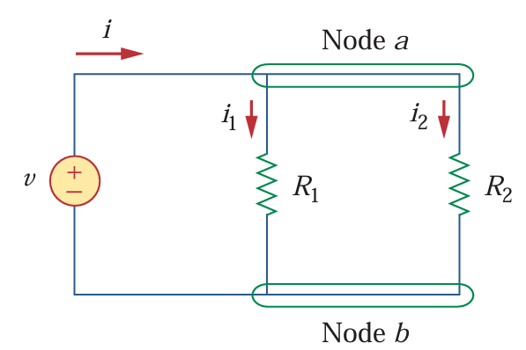
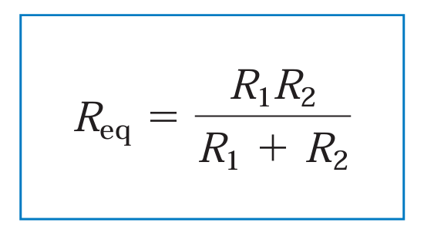
Equivalent Resistance:

Slide 24
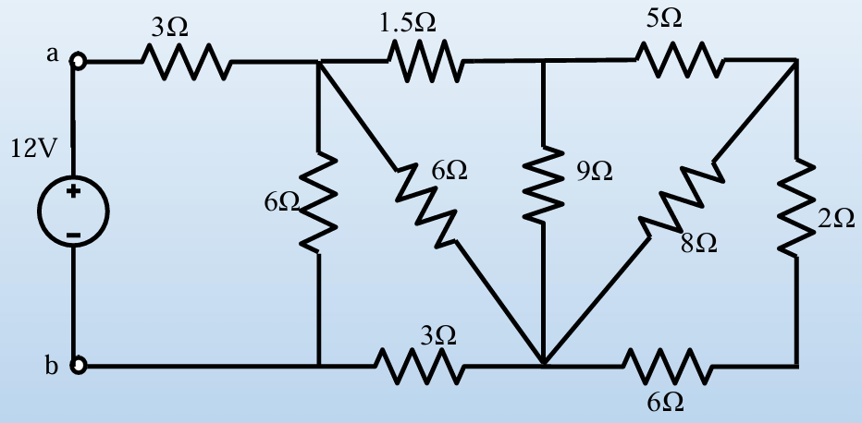
Problem-6

Slide 25
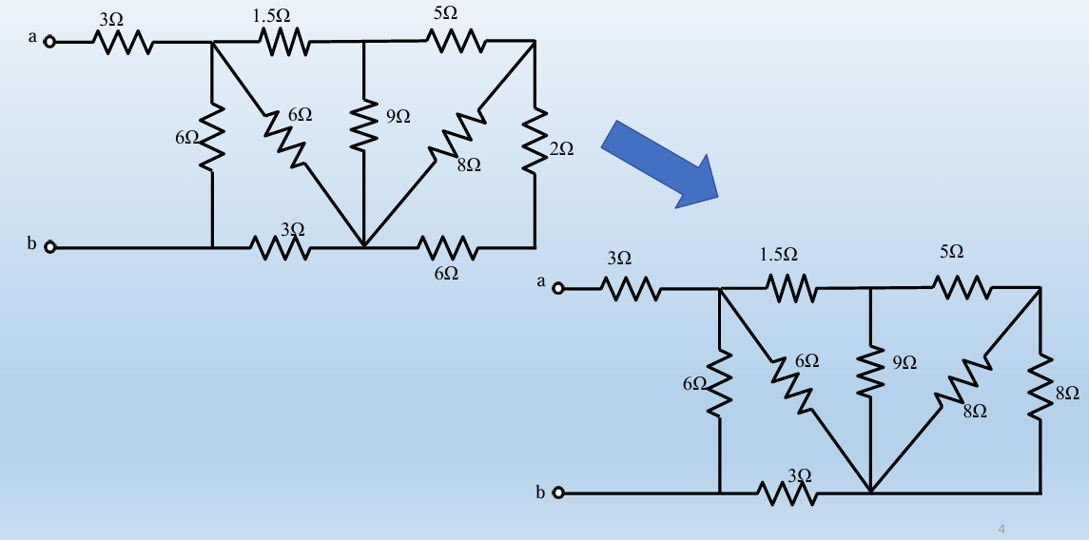

Slide 26
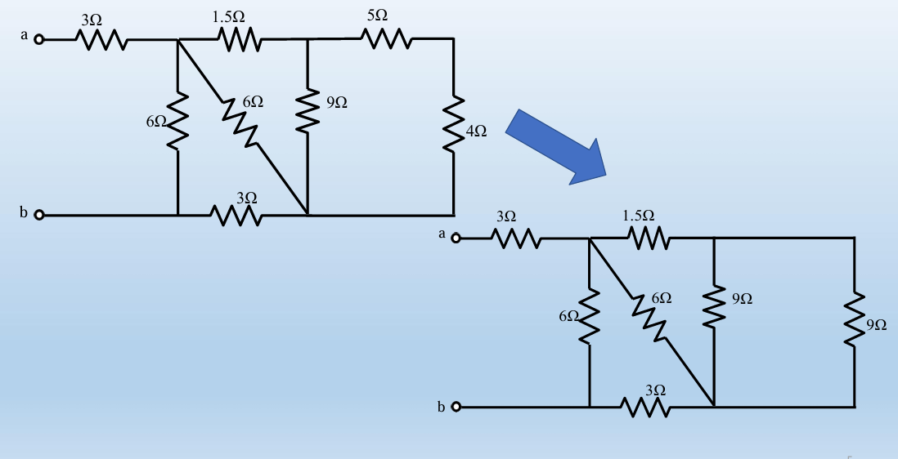

Slide 27
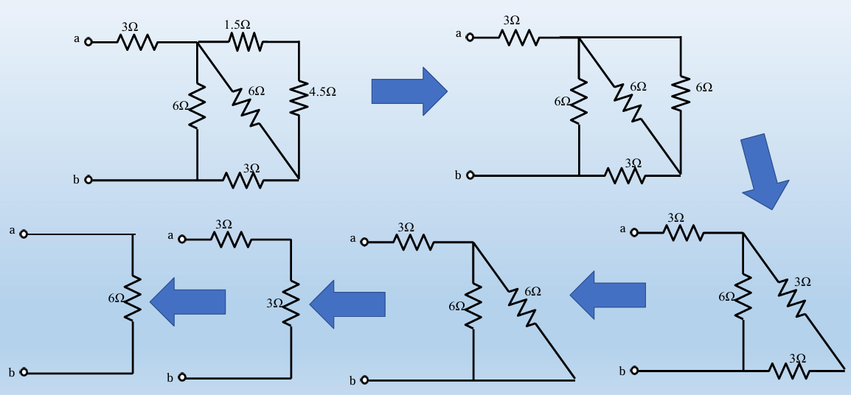

Slide 28
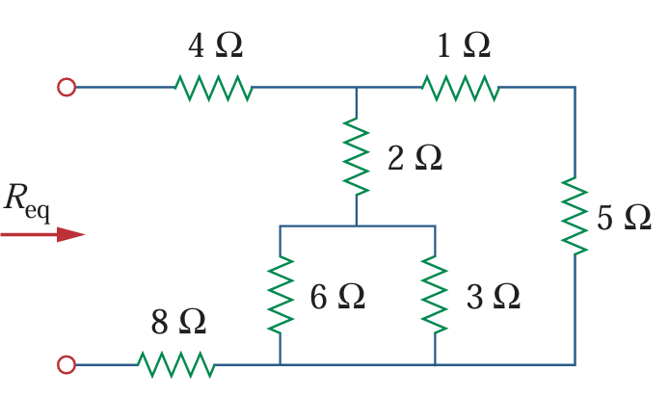
Problem-7

Slide 29
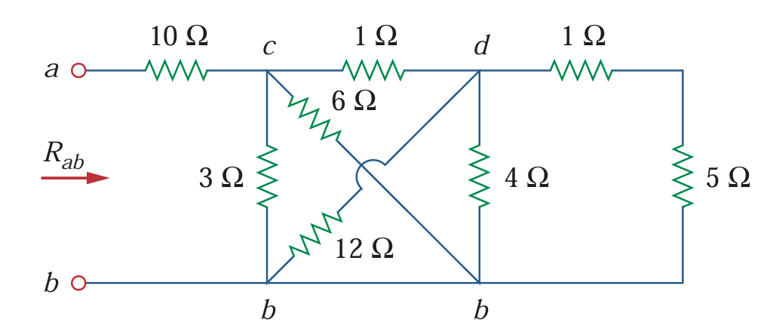
Problem-8

Slide 30
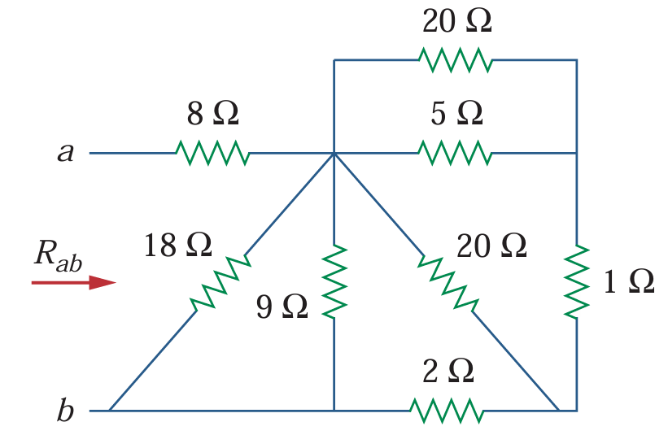
Problem-9

Slide 31
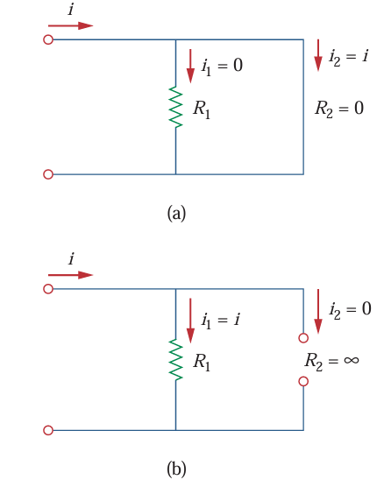

Slide 32
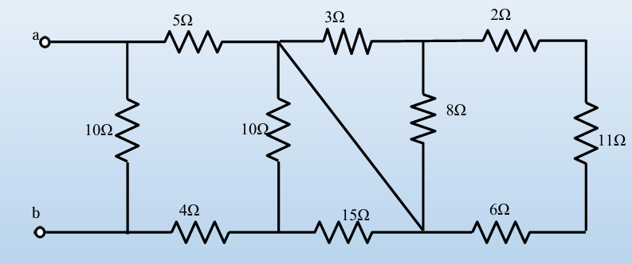
Problem-10

Slide 33
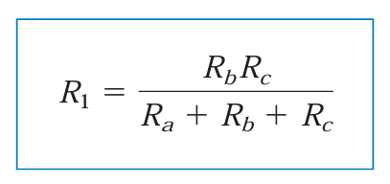
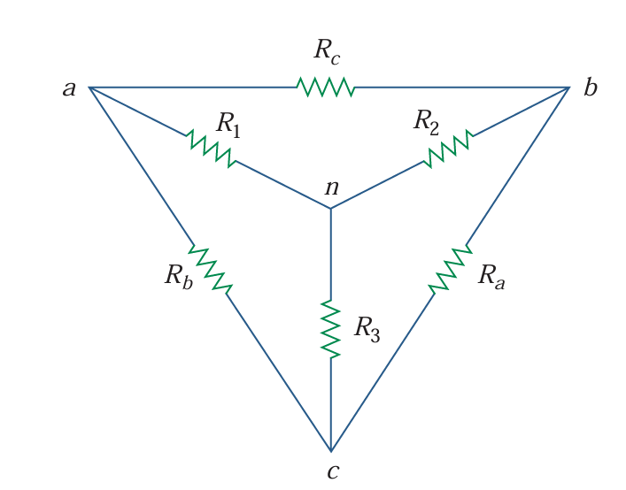
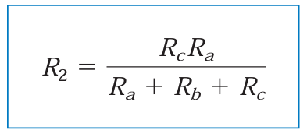
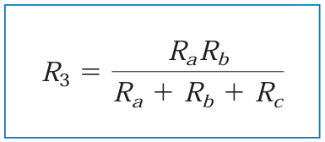
Delta to Wye Conversion:

Slide 34
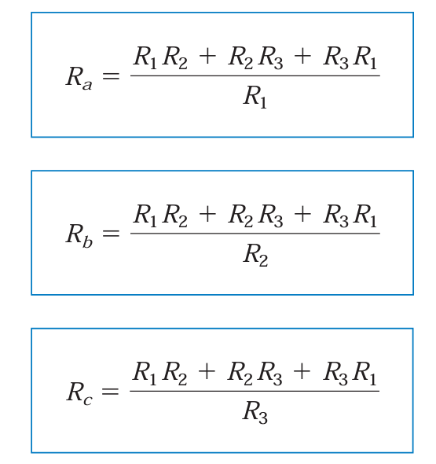
Wye to Delta Conversion:

Slide 35
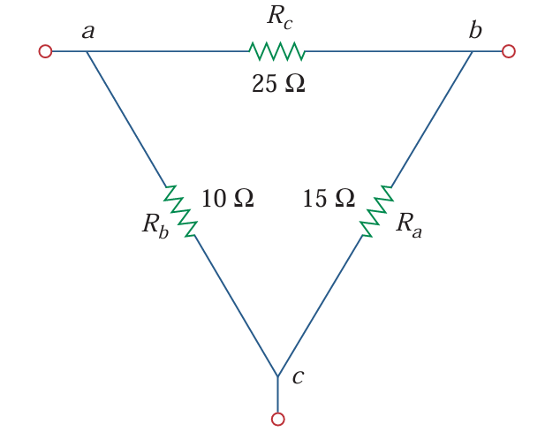
Problem-11

Slide 36
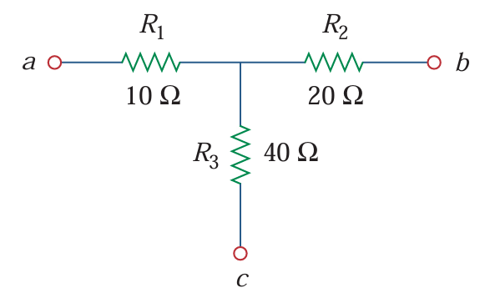
Problem-12

Slide 37
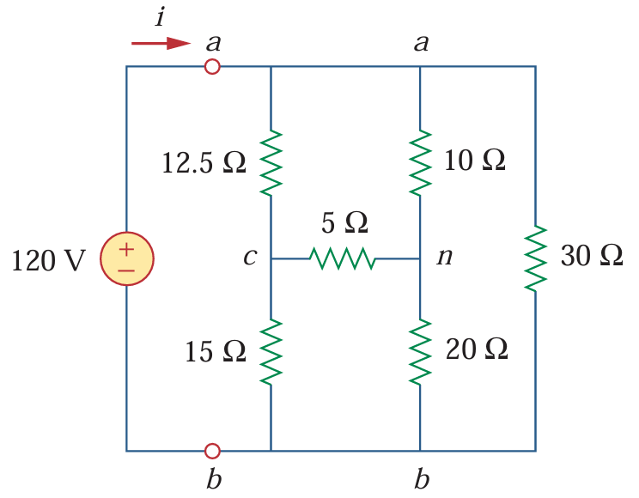
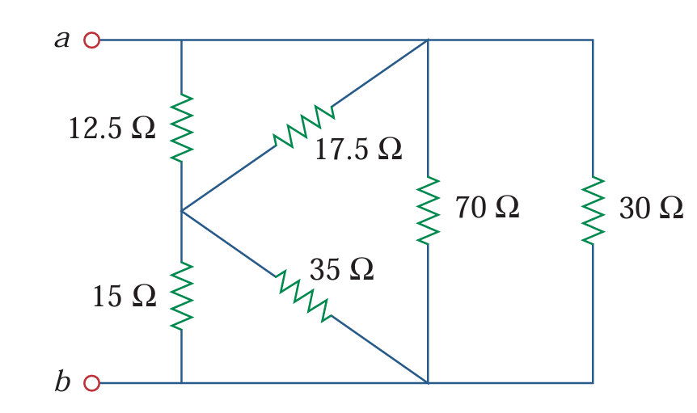
Problem-13

Slide 38
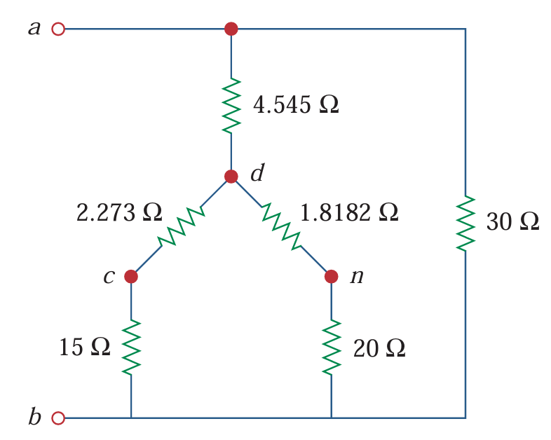
Problem-13 (Alternative way)

Slide 39
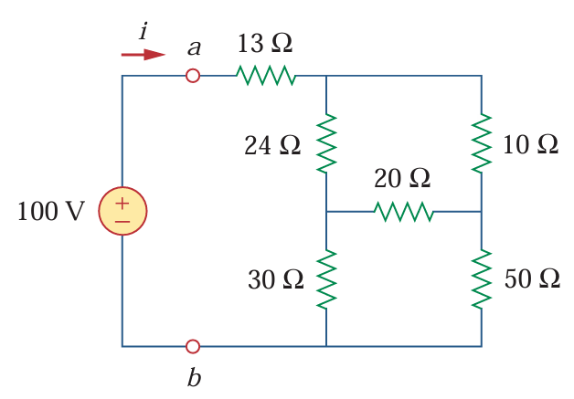
Problem-14

Slide 40
Mesh Analysis:
Steps:
Identify all the mesh in the existing circuit
Assign mesh currents in each mesh, i.e, i₁, i₂, i₃…….i_{n}
Apply KVL in each mesh
Solve the equations

Slide 41
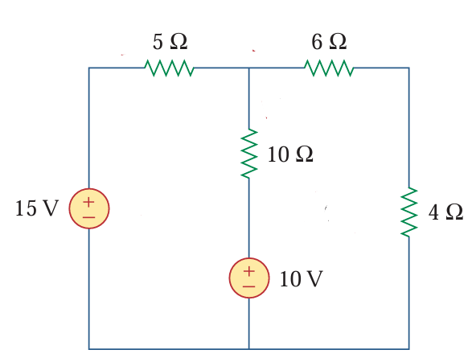
Problem-15

Slide 42
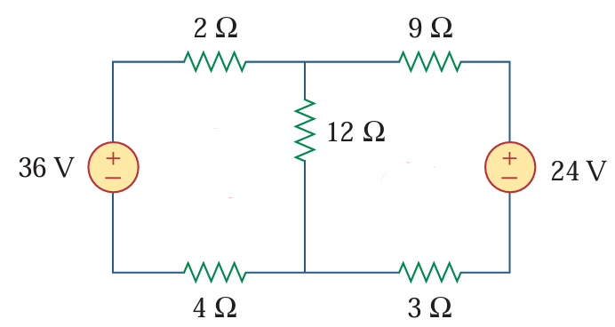
Problem-16

Slide 43
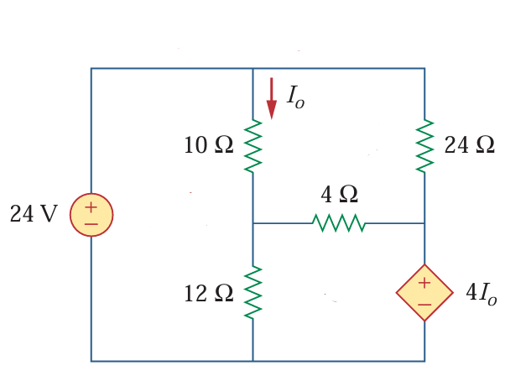
Problem-17

Slide 44
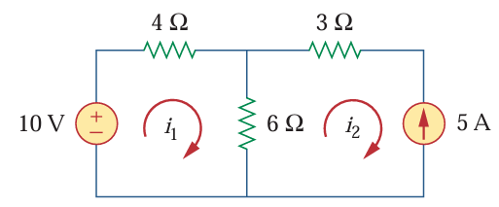
Problem-18

Slide 45
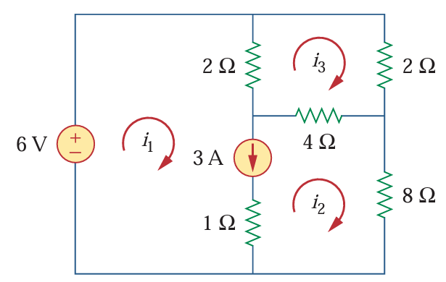
Problem-19

Slide 46
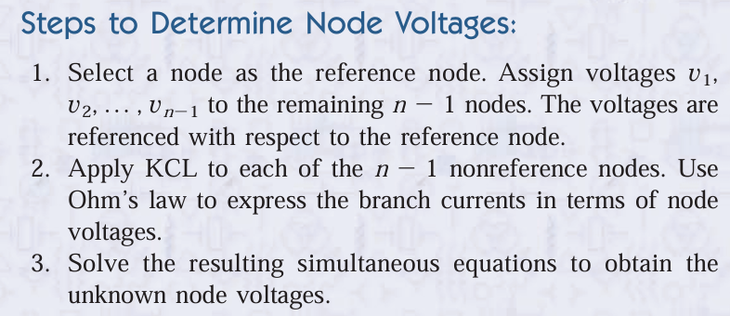
Nodal Analysis:

Slide 47
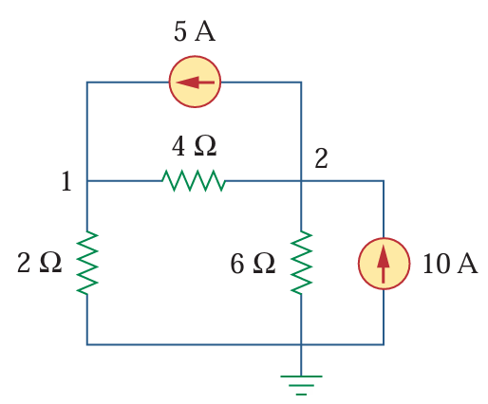
Problem-20

Slide 48
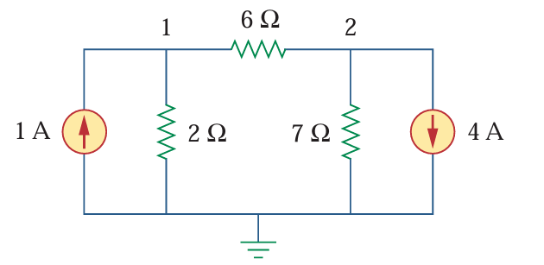
Problem-21

Slide 49
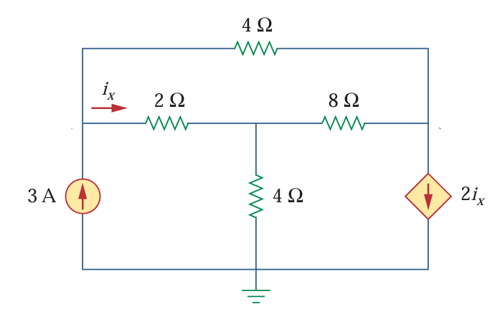
Problem-22

Slide 50
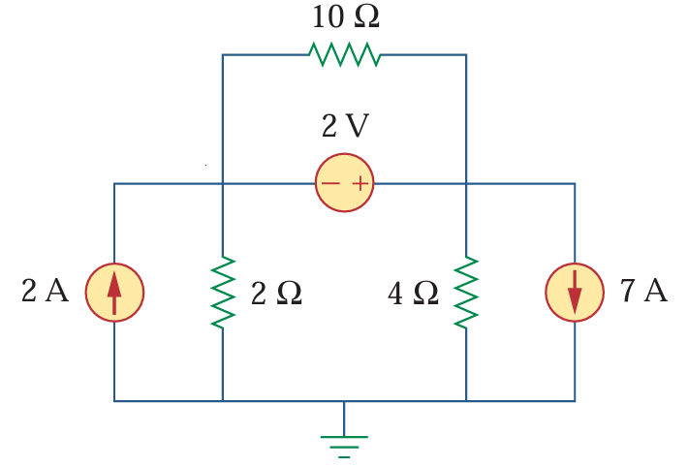
Problem-23

Slide 51
Superposition Theorem:
The superposition principle states that the voltage across (or current through) an element in a linear circuit is the algebraic sum of the voltages across (or currents through) that element due to each independent source acting alone.

Slide 52
Problem-24

Slide 53
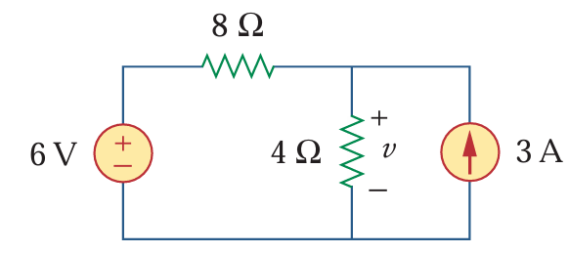
Problem-25

Slide 54
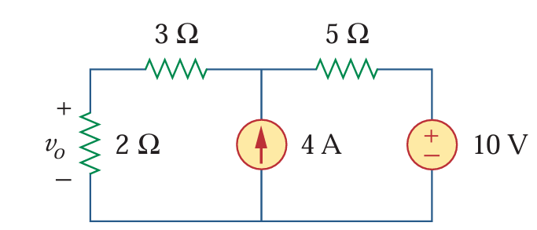
Problem-26

Slide 55
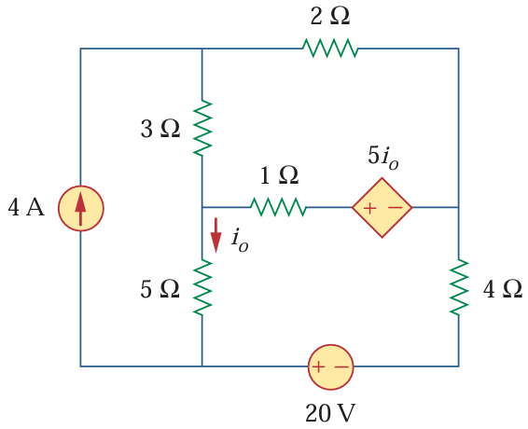
Problem-27

Slide 56


Source Transformation Theorem:
Any circuit consisting a voltage source with a series resistor can be converted into a current source with a parallel resistor and vice versa.

Slide 57

Problem-28

Slide 58

Problem-29

Slide 59

Problem-30

Slide 60

Problem-31

Slide 61



Thevenin’s Theorem:

Slide 62

Problem-32

Slide 63

Problem-33

Slide 64


Maximum Power Transfer Theorem:

Slide 65






Slide 66


